Slide 1



Slide 2

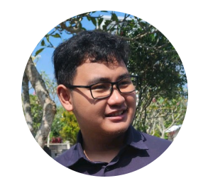
Hello 👋
Kaenova Mahendra Auditama
Tech Lead – Kerjago
Bangkit 2022 Distinction Graduate
Machine Learning Path
Connect with me!
Github: https://github.com/kaenova
LinkedIn: https://www.linkedin.com/in/kaenova/

Slide 3
Sebelum Mulai 📒
Sesi tanya jawab akan diadakan padi sesi tersendiri.
Untuk menanyakan berdasarkan konteks slide,
catat dan gunakan halaman slide

Slide 4
Sebelum Mulai 📒
Adapun contoh kode yang dapat dilihat pada
Github dengan melakukan checkout ke tag
yang tertulis
Gunakan Repository untuk mengikuti:
https://github.com/kaenova/basic-api
dan lakukan
git checkout <example>

Slide 5
Let’s Begin
🚀

Slide 6
Topics for Today
Pengenalan dan Pembuatan API pada HTTP
Studi kasus management Orang
Mengamankan API
Dokumentasi API
Sesi Pertanyaan akan dibuka setiap topik

Slide 7

Pengenalan dan Pembuatan API menggunakan HTTP

Slide 8
Beberapa Istilah Penting!
API - Application Programming Interface
Istilah dimana kita dapat menggunakan suatu aplikasi yang diprogram
HTTP - Hypertext Transfer Protocol (HTTP)
Protokol yang digunakan untuk melakukan transfer data hanya dengan menggunakan text (HyperText)

Slide 9
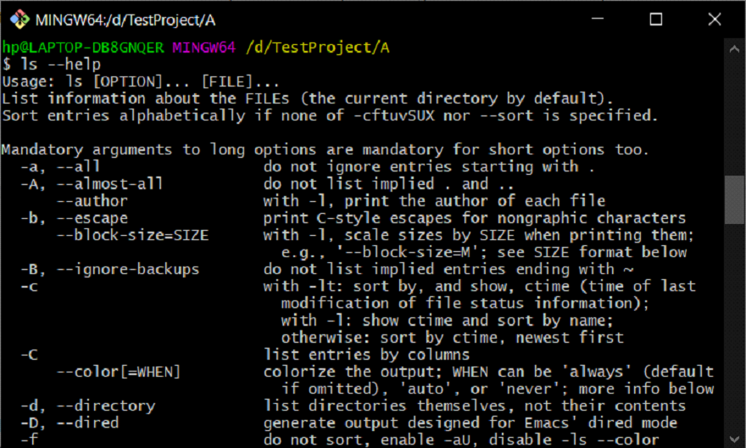
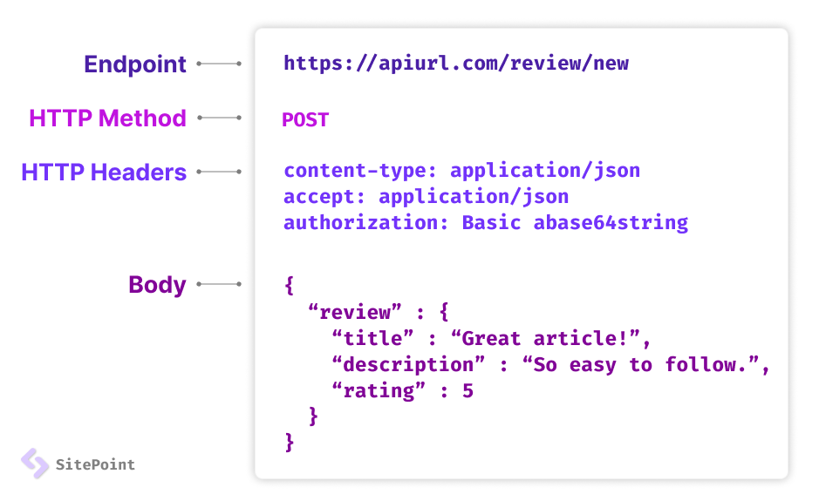
Ada banyak cara untuk membuat suatu API
API - CLI
API - HTTP

Slide 10

Begini Cara Website Bekerja
API - HTTP

Slide 11
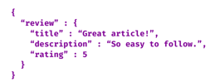
Endpoint
Berawalan dengan /
/review/new
Bagian HTTP yang terpenting
Method
GET, POST, PATCH, DELETE
POST
Body
Text, JSON, HTML

Slide 12
Pertanyaan?

Slide 13
A little Games! 🎮
POST https://kerjago.id/users/new
Method: ? Endpoint: ?

Slide 14
A little Games! 🎮
POST https://kerjago.id/users/new
Method: POST Endpoint: /users/new
GET https://bangkit.academy/
Method: ? Endpoint: ?

Slide 15
A little Games! 🎮
POST https://kerjago.id/users/new
Method: POST Endpoint: /users/new
GET https://bangkit.academy/
Method: GET Endpoint: /
PATCH localhost:3000/newUser
Method: ? Endpoint: ?

Slide 16
A little Games! 🎮
POST https://kerjago.id/users/new
Method: POST Endpoint: /users/new
GET https://bangkit.academy/
Method: GET Endpoint: /
PATCH localhost:3000/newUser
Method: PATCH Endpoint: /newUser
DELETE localhost:3000/user/30
Method: ? Endpoint: ?

Slide 17
A little Games! 🎮
POST https://kerjago.id/users/new
Method: POST Endpoint: /users/new
GET https://bangkit.academy/
Method: GET Endpoint: /
PATCH localhost:3000/newUser
Method: PATCH Endpoint: /newUser
DELETE localhost:3000/user/30
Method: DELETE Endpoint: /user/30

Slide 18
Let’s Code!

Slide 19
Bootstrap w/ Template!
https://github.com/kaenova/simple-express-template

Slide 20

Hello World

Slide 21
const express = require('express')
const app = express()
const port = 3000
app.get('/', (req, res) => {
res.send('Hello World!')
})
app.listen(port, () => {
console.log(`Example app listening on http://localhost:${port}`)
})

Slide 22
const express = require('express')
const app = express()
const port = 3000
// vvv Method
// vvv Endpoint
app.get('/', (req, res) => {
res.send('Hello World!')
// ^^^^^^^^^^^^^^ body
})
app.listen(port, () => {
console.log(`Example app listening on http://localhost:${port}`)
})

Slide 23

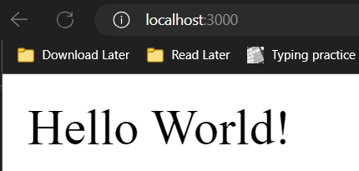
const express = require('express')
const app = express()
const port = 3000
// vvv Method
// vvv Endpoint
app.get('/', (req, res) => {
res.send('Hello World!')
// ^^^^^^^^^^^^^^ body
})
app.listen(port, () => {
console.log(`Example app listening on http://localhost:${port}`)
})

Slide 24
const express = require('express')
const app = express()
const port = 3000
app.get('/', (req, res) => {
res.send('Hello World!')
})
app.get('/hi', (req, res) => {
res.send('Hi World!')
})
app.listen(port, () => {
console.log(`Example app listening on http://localhost:${port}`)
})

Slide 25

const express = require('express')
const app = express()
const port = 3000
app.get('/', (req, res) => {
res.send('Hello World!')
})
app.get('/hi', (req, res) => {
res.send('Hi World!')
})
app.listen(port, () => {
console.log(`Example app listening on http://localhost:${port}`)
})

Slide 26
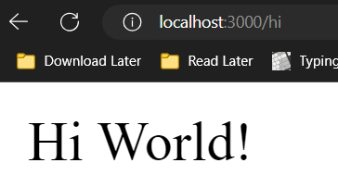
const express = require('express')
const app = express()
const port = 3000
app.get('/', (req, res) => {
res.send('Hello World!')
})
app.get('/hi', (req, res) => {
res.send('Hi World!')
})
app.listen(port, () => {
console.log(`Example app listening on http://localhost:${port}`)
})

Slide 27
Pertanyaan?
😎

Slide 28
Studi kasus management Kontak

Slide 29
Kasus Apa Saja yang Akan Dibuat
Melihat Kontak yang tersedia
Menambahkan kontak
Menghapus Kontak
Update kontak
Menambahkan kontak tapi harus login 🤣

Slide 30
Melihat Kontak Yang Tersedia

Slide 31
const express = require('express')
const app = express()
const port = 3000
app.get('/', (req, res) => {
res.send('Hello World!')
})
app.get('/hi', (req, res) => {
res.send('Hi World!')
})
app.listen(port, () => {
console.log(`Example app listening on http://localhost:${port}`)
})

Slide 32
const express = require('express')
const { getContact } = require('./utils')
const app = express()
const port = 3000
app.get('/', (req, res) => {
res.send('Hello World!')
})
app.get('/getContact', (req, res) => {
const data = getContact()
return res.json(data)
})
app.listen(port, () => {
console.log(`Example app listening on http://localhost:${port}`)
})

Slide 33
const express = require('express')
const { getContact } = require('./utils')
const app = express()
const port = 3000
app.get('/', (req, res) => {
res.send('Hello World!')
})
app.get('/getContact', (req, res) => {
const data = getContact()
return res.json(data)
})
app.listen(port, () => {
console.log(`Example app listening on http://localhost:${port}`)
})
function getContact() {
let jsonData = fs.readFileSync('data.json')
let data = JSON.parse(jsonData)
return data
}

Slide 34
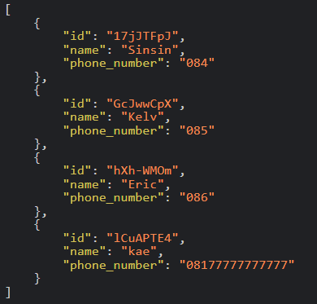
const express = require('express')
const { getContact } = require('./utils')
const app = express()
const port = 3000
app.get('/', (req, res) => {
res.send('Hello World!')
})
app.get('/getContact', (req, res) => {
const data = getContact()
return res.json(data)
})
app.listen(port, () => {
console.log(`Example app listening on http://localhost:${port}`)
})
function getContact() {
let jsonData = fs.readFileSync('data.json')
let data = JSON.parse(jsonData)
return data
}

Slide 35
Menambah Kontak

Slide 36
const express = require('express')
const { getContact } = require('./utils')
const app = express()
const port = 3000
app.get('/', (req, res) => {
res.send('Hello World!')
})
app.get('/getContact', (req, res) => {
const data = getContact()
return res.json(data)
})
app.listen(port, () => {
console.log(`Example app listening on http://localhost:${port}`)
})

Slide 37
const express = require('express')
const { getContact } = require('./utils')
const app = express()
...
app.get('/getContact', (req, res) => {
const data = getContact()
return res.json(data)
})
...

Slide 38
const express = require('express')
const { getContact, addContact } = require('./utils')
const app = express()
...
app.get('/getContact', (req, res) => {
const data = getContact()
return res.json(data)
})
app.post('/addContact', (req, res) => {
addContact(???, ???)
return res.send('Berhasil menambahkan kontak')
})
...
function addContact(name, phoneNumber) {
let id = nanoid(8)
let jsonData = fs.readFileSync('data.json')
let data = JSON.parse(jsonData)
data.push({
"id": id,
"name": name,
"phone_number": phoneNumber
})
jsonData = JSON.stringify(data)
fs.writeFileSync('data.json', jsonData)
}

Slide 39
const express = require('express')
const { getContact, addContact } = require('./utils')
const app = express()
...
app.get('/getContact', (req, res) => {
const data = getContact()
return res.json(data)
})
app.post('/addContact', express.json(), (req, res) => {
const name = req.body.name
const phoneNumber = req.body.phoneNumber
addContact(name, phoneNumber)
return res.send('Berhasil menambahkan kontak')
})
...

Slide 40
const express = require('express')
const { getContact, addContact } = require('./utils')
const app = express()
...
app.get('/getContact', (req, res) => {
const data = getContact()
return res.json(data)
})
// Digunakan untuk mengambil input dari user
// vvvv vvvvvvvvvvvvvv
app.post('/addContact', express.json(), (req, res) => {
const name = req.body.name
const phoneNumber = req.body.phoneNumber
addContact(name, phoneNumber)
return res.send('Berhasil menambahkan kontak')
})
...

Slide 41
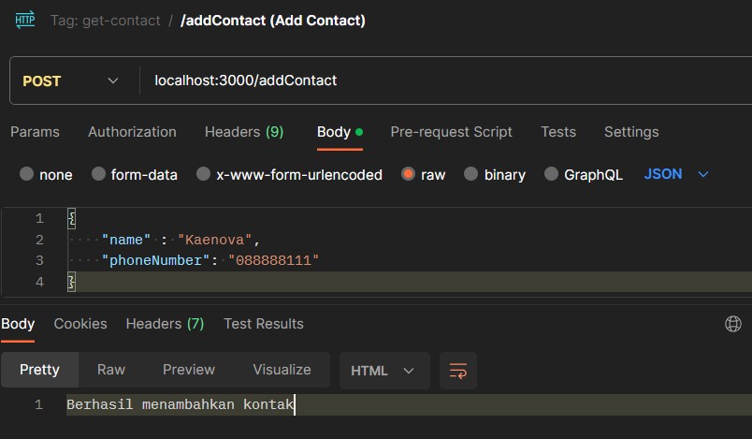
...
app.post('/addContact', express.json(), (req, res) => {
const name = req.body.name
const phoneNumber = req.body.phoneNumber
addContact(name, phoneNumber)
return res.send('Berhasil menambahkan kontak')
})
...

Slide 42
Pertanyaan?

Slide 43
Menghapus Kontak

Slide 44
const express = require('express')
const { getContact, addContact } = require('./utils')
const app = express()
...
app.post('/addContact', express.json(), (req, res) => {
const name = req.body.name
const phoneNumber = req.body.phoneNumber
addContact(name, phoneNumber)
return res.send('Berhasil menambahkan kontak')
})
...

Slide 45
const express = require('express')
const { getContact, addContact, deleteContact } = require('./utils')
const app = express()
...
app.post('/addContact', express.json(), (req, res) => {
const name = req.body.name
const phoneNumber = req.body.phoneNumber
addContact(name, phoneNumber)
return res.send('Berhasil menambahkan kontak')
})
...
function deleteContact(id) {
let jsonData = fs.readFileSync('data.json')
let data = JSON.parse(jsonData)
// search through data by looping
const index = data.findIndex((temp) => temp.id === id)
if (index === -1) {
return false
}
data.splice(index, 1)
jsonData = JSON.stringify(data)
fs.writeFileSync('data.json', jsonData)
return true
}

Slide 46
const express = require('express')
const { getContact, addContact, deleteContact } = require('./utils')
const app = express()
...
app.post('/addContact', express.json(), (req, res) => {
const name = req.body.name
const phoneNumber = req.body.phoneNumber
addContact(name, phoneNumber)
return res.send('Berhasil menambahkan kontak')
})
app.delete('/deleteContact', express.json(), (req, res) => {
const id = req.body.id
if (deleteContact(id)) {
return res.send('Berhasil menghapus kontak')
} else {
return res.send("Gagal menghapus kontak")
}
})
...

Slide 47
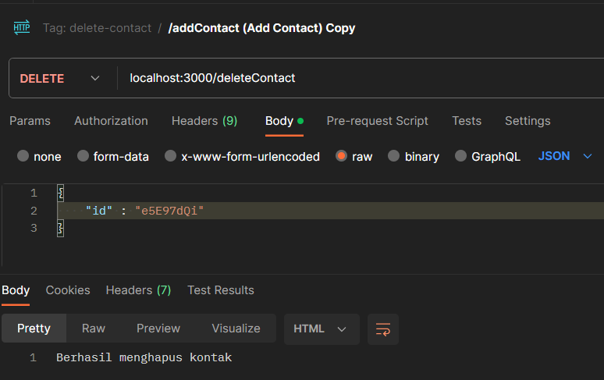
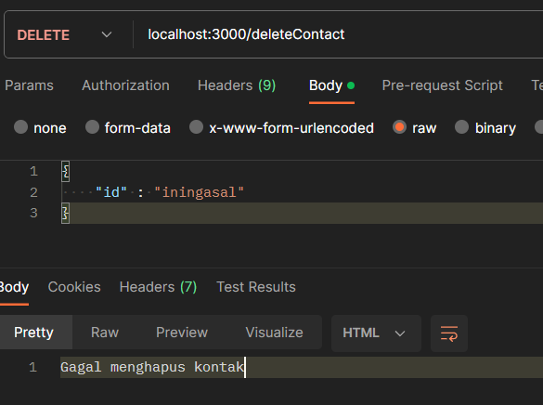
const express = require('express')
const { getContact, addContact, deleteContact } = require('./utils')
const app = express()
...
app.delete('/deleteContact', express.json(), (req, res) => {
const id = req.body.id
if (deleteContact(id)) {
return res.send('Berhasil menghapus kontak')
} else {
return res.send("Gagal menghapus kontak")
}
})
...

Slide 48
Update Kontak

Slide 49
function updateContact(id, name, phoneNumber) {
let jsonData = fs.readFileSync('data.json')
let data = JSON.parse(jsonData)
// search through data by looping
const index = data.findIndex((temp) => temp.id === id)
if (index === -1) {
return false
}
data[index].name = nama
data[index].phoneNumber = phoneNumber
jsonData = JSON.stringify(data)
fs.writeFileSync('data.json', jsonData)
return true
}

Slide 50
const express = require('express')
const { getContact, addContact, deleteContact, updateContact } = require('./utils')
const app = express()
...
app.patch('/updateContact', express.json(), (req, res) => {
const id = req.body.id
const name = req.body.name
const phoneNumber = req.body.phoneNumber
if (updateContact(id, name, phoneNumber)) {
return res.send('Berhasil mengupdate kontak')
} else {
return res.send("Gagal mengupdate kontak")
}
})
...

Slide 51
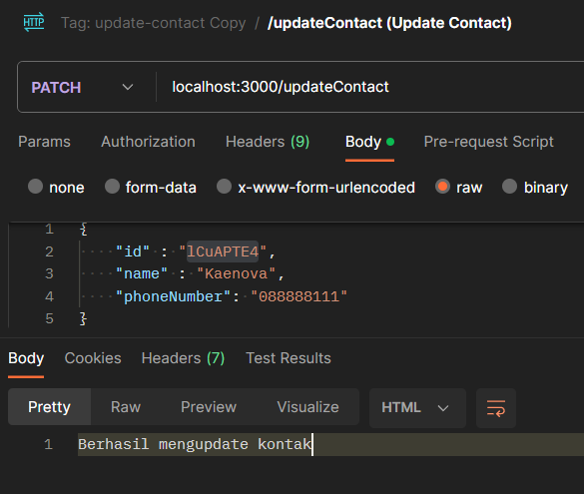
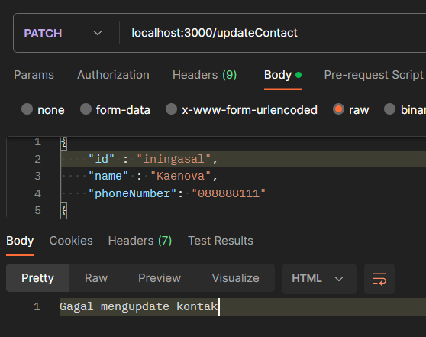
const express = require('express')
const { getContact, addContact, deleteContact, updateContact } = require('./utils')
const app = express()
...
app.patch('/updateContact', express.json(), (req, res) => {
const id = req.body.id
const name = req.body.name
const phoneNumber = req.body.phoneNumber
if (updateContact(id, name, phoneNumber)) {
return res.send('Berhasil mengupdate kontak')
} else {
return res.send("Gagal mengupdate kontak")
}
})
...

Slide 52
So far....

Slide 53
app.get('/getContact', (req, res) => {
const data = getContact()
return res.json(data)
})
app.post('/addContact', express.json(), (req, res) => {
const name = req.body.name
const phoneNumber = req.body.phoneNumber
addContact(name, phoneNumber)
return res.send('Berhasil menambahkan kontak')
})
app.delete('/deleteContact', express.json(), (req, res) => {
const id = req.body.id
if (deleteContact(id)) {
return res.send('Berhasil menghapus kontak')
} else {
return res.send("Gagal menghapus kontak")
}
})
app.patch('/updateContact', express.json(), (req, res) => {
const id = req.body.id
const name = req.body.name
const phoneNumber = req.body.phoneNumber
if (updateContact(id, name, phoneNumber)) {
return res.send('Berhasil mengupdate kontak')
} else {
return res.send("Gagal mengupdate kontak")
}
})

Slide 54
app.get('/contact', (req, res) => {
const data = getContact()
return res.json(data)
})
app.post('/contact', express.json(), (req, res) => {
const name = req.body.name
const phoneNumber = req.body.phoneNumber
addContact(name, phoneNumber)
return res.send('Berhasil menambahkan kontak')
})
app.delete('/contact', express.json(), (req, res) => {
const id = req.body.id
if (deleteContact(id)) {
return res.send('Berhasil menghapus kontak')
} else {
return res.send("Gagal menghapus kontak")
}
})
app.patch('/contact', express.json(), (req, res) => {
const id = req.body.id
const name = req.body.name
const phoneNumber = req.body.phoneNumber
if (updateContact(id, name, phoneNumber)) {
return res.send('Berhasil mengupdate kontak')
} else {
return res.send("Gagal mengupdate kontak")
}
})

Slide 55
Let’s Break

Slide 56
Menambahkan kontak tapi harus login 🤣

Slide 57
Mari kita melihat bagaimana cara menambahkan kontak dari yang sudah dibuat

Slide 58
app.post('/contact', express.json(), (req, res) => {
const name = req.body.name
const phoneNumber = req.body.phoneNumber
addContact(name, phoneNumber)
return res.send('Berhasil menambahkan kontak')
})
Mari kita melihat bagaimana cara menambahkan kontak dari yang sudah dibuat

Slide 59
app.post('/contact', express.json(), (req, res) => {
// Butuh penjagaan penggunaan
const name = req.body.name
const phoneNumber = req.body.phoneNumber
addContact(name, phoneNumber)
return res.send('Berhasil menambahkan kontak')
})
Mari kita melihat bagaimana cara menambahkan kontak dari yang sudah dibuat

Slide 60
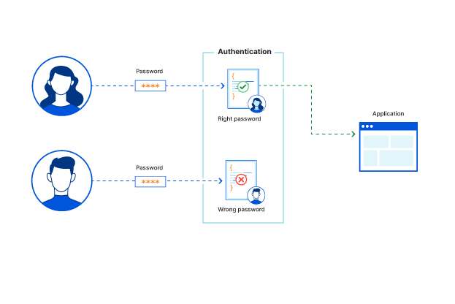
Apa itu Login
Untuk apa?

Slide 61
User
Server
1. Login dengan
Email dan password
2. Server Memberikan
Kode Unik yang bisa digunakan
3. Daftar Kontak baru
Dengan membawa kode unik
3. Permintaan User Diterima / Digagalkan

Slide 62
app.post('/contact', express.json(), (req, res) => {
// Butuh penjagaan penggunaan
const name = req.body.name
const phoneNumber = req.body.phoneNumber
addContact(name, phoneNumber)
return res.send('Berhasil menambahkan kontak')
})
Butuh Kode unik yang diberikan oleh server sebagai penjagaan

Slide 63
const serverKeyWord = 'apa hayoo'
app.post('/contact', express.json(), (req, res) => {
// Butuh penjagaan login
const userKeyWord = req.body.keyWord
if (userKeyWord !== serverKeyWord) {
return res.send('Anda tidak diperbolehkan menggunakan API ini')
}
const name = req.body.name
const phoneNumber = req.body.phoneNumber
addContact(name, phoneNumber)
return res.send('Berhasil menambahkan kontak')
})
Butuh Kode unik yang diberikan oleh server sebagai penjagaan

Slide 64
const serverKeyWord = 'apa hayoo'
app.post('/contact', express.json(), (req, res) => {
// Butuh penjagaan login
const userKeyWord = req.body.keyWord
if (userKeyWord !== serverKeyWord) {
return res.send('Anda tidak diperbolehkan menggunakan API ini')
}
const name = req.body.name
const phoneNumber = req.body.phoneNumber
addContact(name, phoneNumber)
return res.send('Berhasil menambahkan kontak')
})
app.post('/login', express.json(), (req, res) => {
const email = req.body.email
const password = req.body.password
// Sebagai contoh pengecekkan email dan password
// Lebih aman dengan disimpan di database serta password
// yang di encrypt dgn bcrypt
if (email === 'kaenova' && password == 'kerjago') {
return res.send(serverKeyWord)
}
return res.send("Anda salah password")
})

Slide 65
Dengan konsep yang sama,
Gunakan penjagaan menggunakan JWT untuk membuat kode unik dan memverifikasi kode tersebut
https://github.com/kaenova/teach-basic-api
git clone https://github.com/kaenova/teach-basic-api.git
git checkout authentication-jwt

Slide 66
Pertanyaan?

Slide 67
Document Your HTTP API!

Slide 68
Kita akan gunakan Postman dari kode yang dibuat
app.get('/', (req, res) => {
res.send('Hello World!')
})
app.get('/contact', (req, res) => {
const data = getContact()
return res.json(data)
})
app.post('/contact', express.json(), (req, res) => {
// Butuh penjagaan login
try {
const userKeyWord = req.body.keyWord
jwt.verify(userKeyWord, serverSecret)
} catch (e) {
return res.send('Anda tidak diperbolehkan menggunakan API ini')
}
const name = req.body.name
const phoneNumber = req.body.phoneNumber
addContact(name, phoneNumber)
return res.send('Berhasil menambahkan kontak')
})
app.delete('/contact', express.json(), (req, res) => {
const id = req.body.id
if (deleteContact(id)) {
return res.send('Berhasil menghapus kontak')
} else {
return res.send("Gagal menghapus kontak")
}
})
app.patch('/contact', express.json(), (req, res) => {
const id = req.body.id
const name = req.body.name
const phoneNumber = req.body.phoneNumber
if (updateContact(id, name, phoneNumber)) {
return res.send('Berhasil mengupdate kontak')
} else {
return res.send("Gagal mengupdate kontak")
}
})
app.post('/login', express.json(), (req, res) => {
const email = req.body.email
const password = req.body.password
// Sebagai contoh pengecekkan email dan password
// Lebih aman dengan disimpan di database serta password
// yang di encrypt dgn bcrypt
if (email === 'kaenova@bangkit.academy' && password == 'kerjago') {
return res.send(jwt.sign({ email: email }, serverSecret))
}
return res.send("Anda salah password")
})
app.listen(port, () => {
console.log(`Example app listening on http://localhost:${port}`)
})

Slide 69

Live Demo using Postman!

Slide 70
QnA
Session!

Slide 71

That’s It
Thank You! 👋
Feedback are welcomed!
https://bit.ly/kae-mentor-feedback
Connect with me!
Github: https://github.com/kaenova
LinkedIn: https://www.linkedin.com/in/kaenova/

